Slide 1

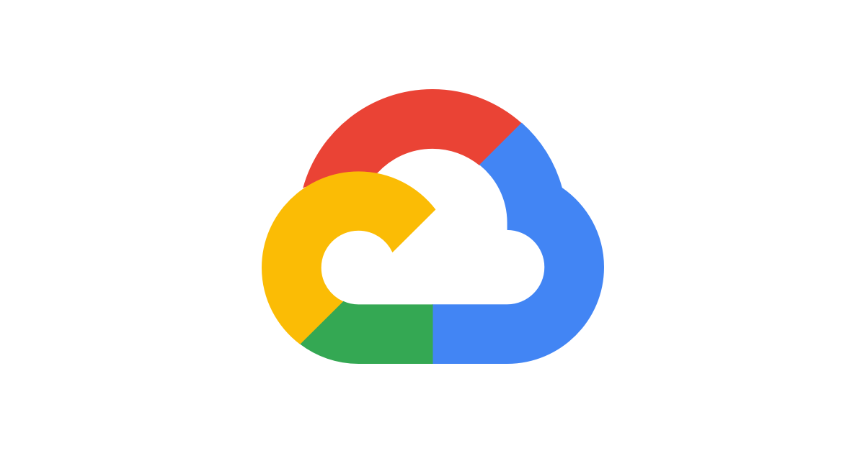
CSCI 6560 Project: Role-based Data Sharing Application
with GCP
Jessica Wijaya
Joseph May
Kyle DuBray

Slide 2
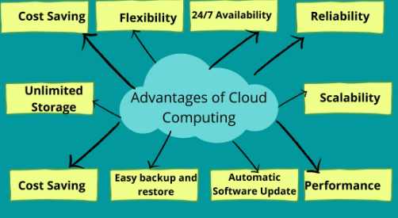
Why Cloud?

Slide 3
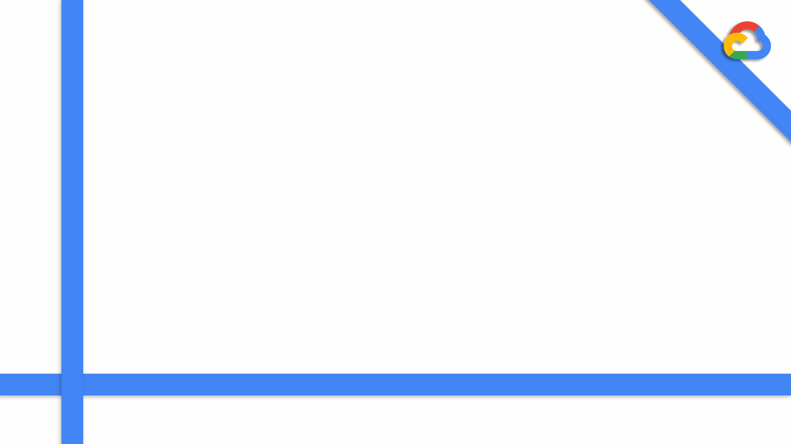
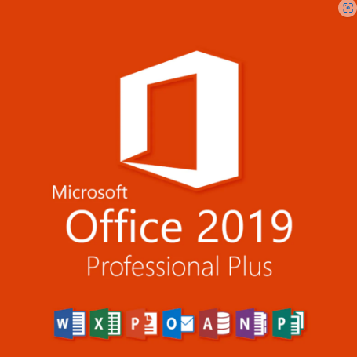
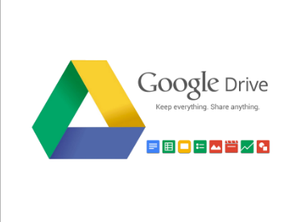
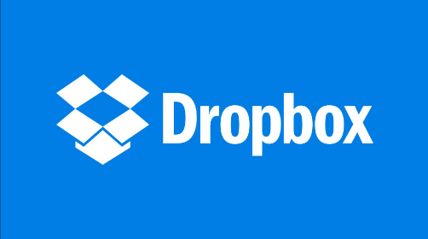
Similar Products

Slide 4



Concept
Create a role-based data sharing application hosted with Google Cloud Platform.
It's data sharing features include:
Cloud-hosted Data
User Roles
Highly Configurable Share Options

Slide 5
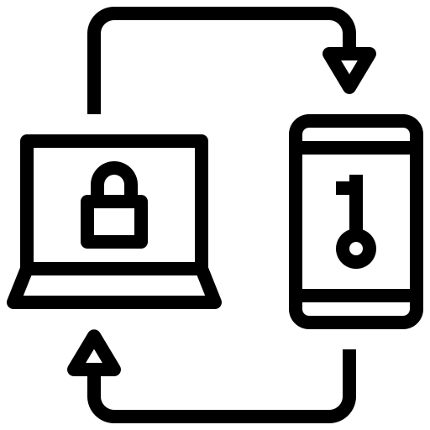

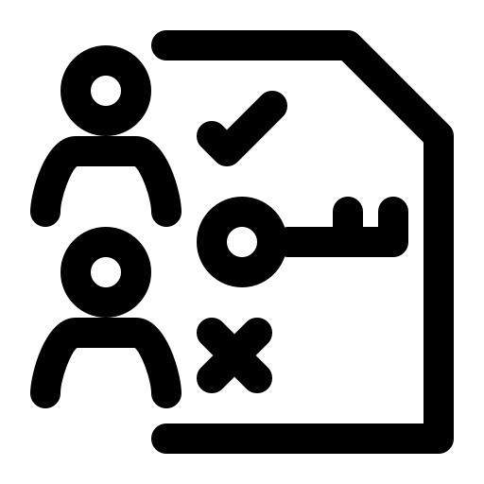
Concept
The goal is to create a role-based data sharing application hosted with Google Cloud Platform.
It's security features include:
2-Factor Authentication
Data Encryption
Hierarchical Access Control

Slide 6
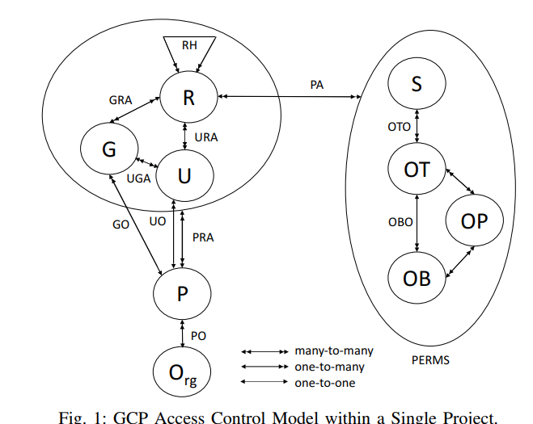
Concept- Access Control Model
A model by D. Gupta et. al. in shows GCP's access control model [3].
It stems from organizations that can have multiple projects.
Within projects, complex access control can be configured for different resources.
[3] D. Gupta, S. Bhatt, M. Gupta, O. Kayode., A. S. Tosun “Access Control Model for Google Cloud IoT,” \textit{2020 IEEE 6th Intl Conference on Big Data Security on Cloud (BigDataSecurity), IEEE Intl Conference on High Performance and Smart Computing, (HPSC) and IEEE Intl Conference on Intelligent Data and Security (IDS)}, Baltimore, MD, USA, 2020, pp. 198-208, doi: 10.1109/BigDataSecurity-HPSC-IDS49724.2020.00044..

Slide 7
Concept- Access Control Model
Our model is a simplification and abstraction of the GCP model.
Rather than stemming from organizations, it will stem from users.
Specifically, it will allow non-technical users to have flexible configurability without compromising on security.
[3] D. Gupta, S. Bhatt, M. Gupta, O. Kayode., A. S. Tosun “Access Control Model for Google Cloud IoT,” \textit{2020 IEEE 6th Intl Conference on Big Data Security on Cloud (BigDataSecurity), IEEE Intl Conference on High Performance and Smart Computing, (HPSC) and IEEE Intl Conference on Intelligent Data and Security (IDS)}, Baltimore, MD, USA, 2020, pp. 198-208, doi: 10.1109/BigDataSecurity-HPSC-IDS49724.2020.00044..

Slide 8
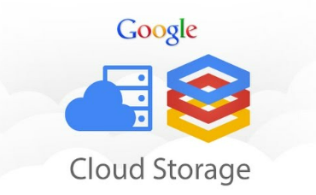
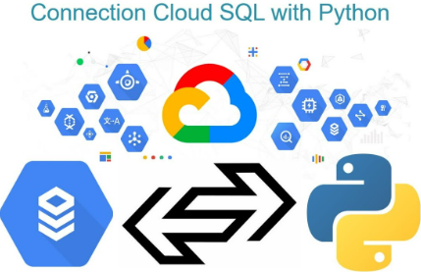
GCP Features
GCP Cloud Storage Buckets
SQL in GCP

Slide 9
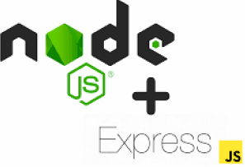

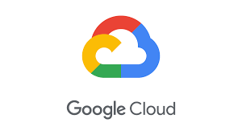
Technologies
​Node.js and Express- Node is a server-side runtime for JavaScript, and Express is a framework for creating web servers with Node.
MySQL- a relational database management system – the keystone of the application. It will contain the access control model and all associated data.
Google Cloud Platform- The public cloud hosting platform on which we will deploy our node application and MySQL storage. We will also use "buckets" on Google Cloud for storing files.

Slide 10
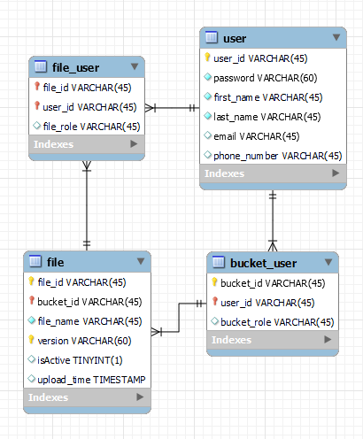
Database Model
User table stores necessary user information with user_id as the primary key. Passwords are stored after being passed through a hash function.
Bucket_user table keeps track of the roles each user has for each bucket.
File_user table stores the roles a user has for a file.
File table contains metadata for each file such as version, timestamp, and indicates which version is active.

Slide 11
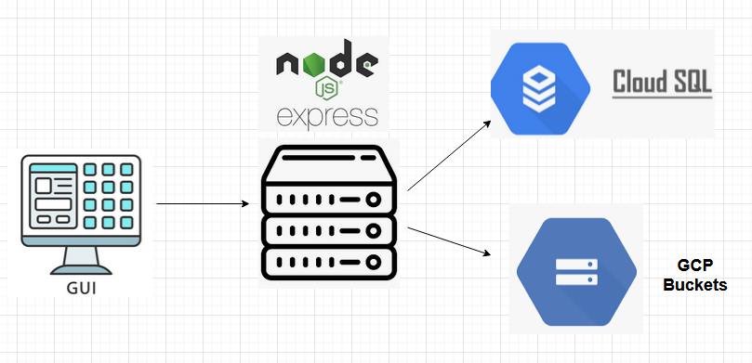
Node Server
Node server with Express framework will connect to MySQL database in the cloud.
Server will act as intermediary between the UI and database.
UI will send requests to the server to update tables and store user information and roles.

Slide 12
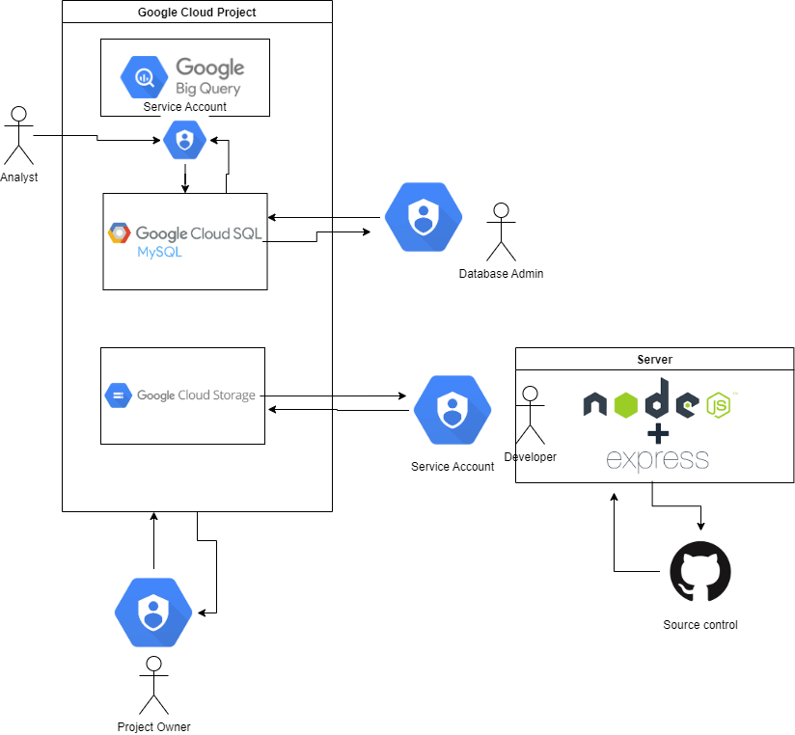
Architecture

Slide 13
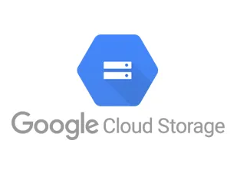
Google Cloud Storage
Files are stored within GCP buckets and accessed through a service account.
Node server uses the service account to do operations upon the buckets.
Server has API endpoints to create buckets, delete buckets, add files, update files, etc.
Buckets are configured to allow file versioning. Each time a file is updated the old version becomes non-current and has a generation number added to its name to remain accessible.

Slide 14
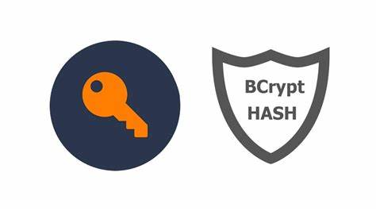
Password Encryption
Passwords are encrypted using Bcrypt
Bcrypt includes a salt, which is a unique value added so each hash is unique.
This makes Bcrypted data more resistant to rainbow table hack attempts.
Bcrypt also features protections against brute force attacks because it is an adaptive function that can be slowed over time.

Slide 15
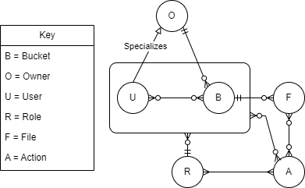
Access Control Model
A user can create a bucket, at which point they become the Owner of that bucket (buckets can only have one owner).
Each user can only have one role in each bucket in which they participate.
A bucket contains files.
Actions can be performed for both files and participating users in a bucket.
Which actions are permissible depends on the requesting user's bucket roles.

Slide 16
Access Control Model- File Roles
*Roles of higher security levels also include permissions of preceding role(s)*
File Viewer
Read files (download)
File Editor
Update a file
Upload a file to a bucket with the same name as a file that already exists
Can delete any file that they have uploaded
File Owner
Delete a file
Delist the file (soft deletion)

Slide 17
Access Control Model- Bucket Roles
Viewer
View files in a bucket
Restricted editor
Create new files
Soft delete files they have uploaded
Editor:
Update existing files
Soft delete any file
Maintainer
Assign bucket and file roles to users
Restore old file versions
Role permissions can only be changed by the bucket owner
Owner
Delete the bucket
Transfer ownership role
Hard delete a file

Slide 18
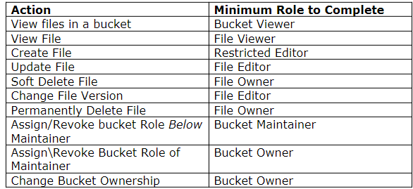
Action, Minimum Level Role

Slide 19
JM
Authentication and Authorization
The arguably most crucial aspect of security for our application is making sure that anyone who makes a request to the server is:
Authenticated- who they say they are
AND
Authorized- allowed to perform the requested action.
How should this be implemented?

Slide 20
Authentication and Authorization
App Authentication
Flexibility/Independence (deploy anywhere, users use any email, etc.)
Freedom with architecture/design decisions- we can use Google resources only when necessary with the use of the GCP Nodejs client.
*A future feature could be the option to authenticate with a Google account.

Slide 21
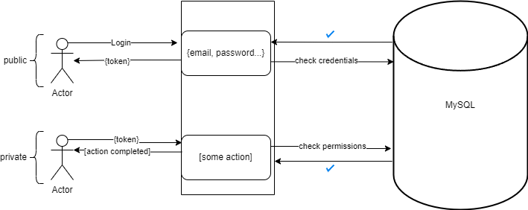
Authentication and Authorization-
basic request flow

Slide 22
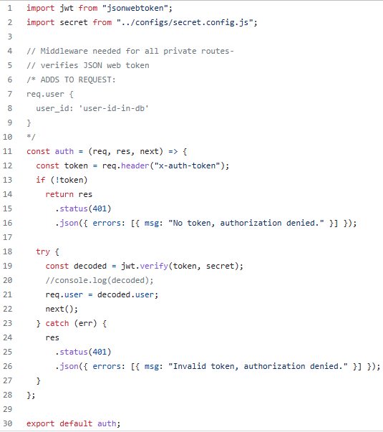
Authentication MiddleWare
Check for token in the header.
Verify that token value against a secret we set. Secrets must match, or access will be denied.
Any routes in the app that need authorization will have this auth function passed as the 2nd argument.

Slide 23
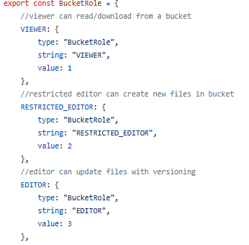
Role ENUM
Actions & roles have been mapped to an enum. Each role and action has an associated number.
When a user is trying to perform an action: check the requested action against our database to see if the user has the required permissions for that action.

Slide 24
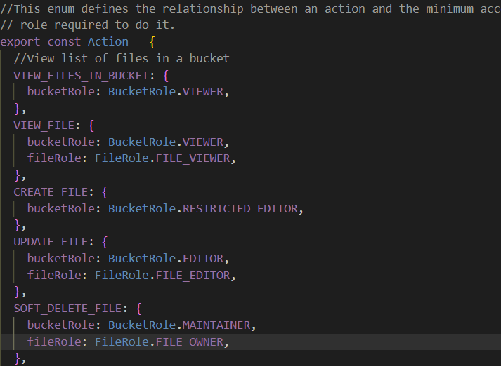
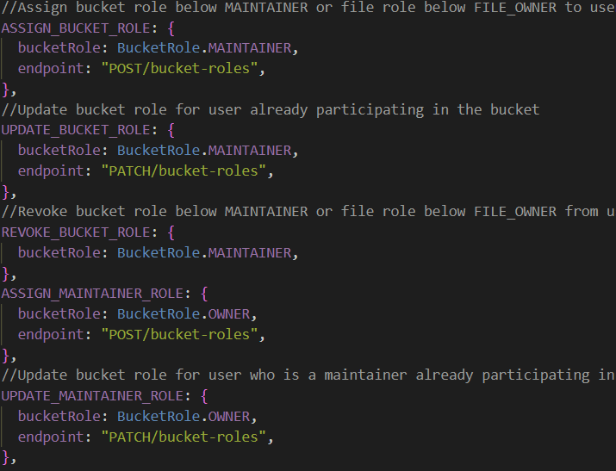
Action ENUM

Slide 25
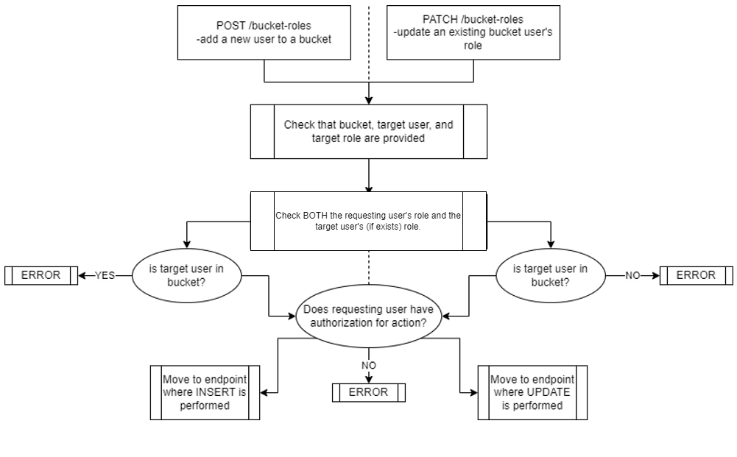
Access Request Chart
High Error Environment
Not Provided
Error

Slide 26
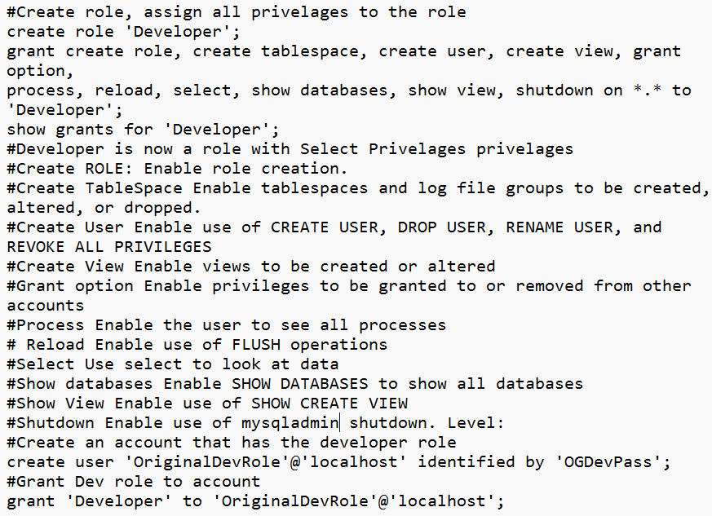

Developer Role
Specialized backend role only available to employees of the application developers.
Intended for auditing, help ticketing/support, setup initial buckets for an organization
2 Factor Authorization settings

Slide 27
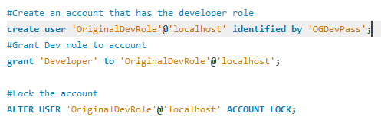
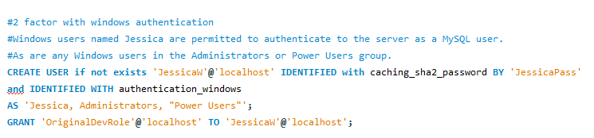
Developer Role

Slide 28
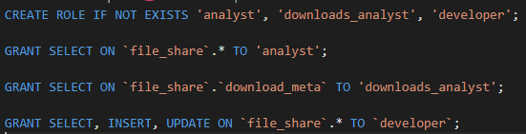
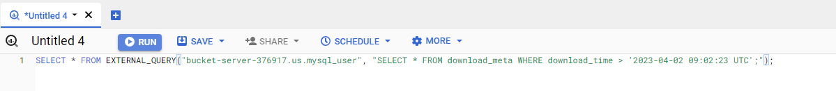
Cloud Roles- Analyst and Developer
New Contributors to the project in the cloud provided specific role(s). Listed here:
developer- can perform selects, inserts, and updates in entire database.
analyst- only selects in entire database.
downloads_analyst- only selects on the downloads table.
The analyst roles can access the database through bigquery to gain insights on users, buckets, files, and roles.

Slide 29
Conclusion
Data storage and sharing application that uses NodeJS, GCP Cloud SQL, and GCP buckets.
Secured through a role management system with roles available at the bucket and file levels.
User roles are stored in the database which is secured via GCP, and are implemented through an enum class
Certain user data has been encrypted with bcrypt for protection and confidentiality, and users are verified through a json web token.
Files stored in the system are only able to be deleted by a file owner, helping maintain the integrity of data.
Soft deletion acts like the recycle bin on a PC so data may still be retrieved if the users want to undo a deletion. Users may access old versions of files should that become necessary, which increases the availability of data within the system.

Slide 30
Video
https://youtu.be/UbxZngM5-mg

Slide 31
References
S. D. Müller, S. R. Holm, and J. Søndergaard, “Benefits of cloud computing: Literature review in a maturity model perspective,” Communications of the Association for Information Systems, vol. 37, 2015.
Sandesh Achar et al. "Data Security in Cloud: A Review," in Asian Journal of Advances in Research, 17th ed., vol. 4, pp. 76--83.
D. Gupta, S. Bhatt, M. Gupta, O. Kayode., A. S. Tosun “Access Control Model for Google Cloud IoT,” \textit{2020 IEEE 6th Intl Conference on Big Data Security on Cloud (BigDataSecurity), IEEE Intl Conference on High Performance and Smart Computing, (HPSC) and IEEE Intl Conference on Intelligent Data and Security (IDS)}, Baltimore, MD, USA, 2020, pp. 198-208, doi: 10.1109/BigDataSecurity-HPSC-IDS49724.2020.00044..

